Slide 1


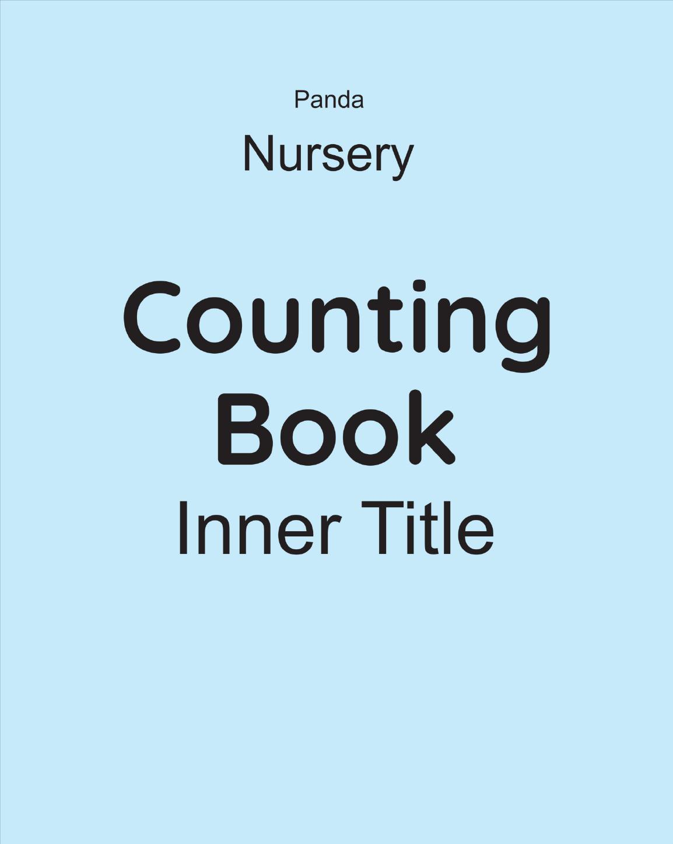
Panda Counting Book
Nursery • Age 4+
An activity-based early-years book from the Panda Series.
A Project of Azhar Publishers & Book Factory

Slide 2
i
What's Inside
Panda Counting Book Nursery • Age 4+
1
Numbers 1 to 20 — trace, count and write
2
Reading & writing numbers 1 to 50
3
Addition with picture and dot support
4
Subtraction with cross-out and dots
5
Longer & smaller, heavy & light, same & different
6
Time, days of the week and months of the year

Slide 3
★
Purpose & Classroom Support
Builds confident early number skills — counting, writing, addition, subtraction and everyday concepts — through clear pictures and guided practice.
“
Every book comes with
1
2
3
Teacher's Lesson Plan
Practice Papers
Digital Interactive Version
A 40-week lesson plan that guides teachers, day by day.
Monthly tests and term exam papers for children to attempt.
An interactive flipbook and digital exercises for engaging, screen-based practice.
A Project of Azhar Publishers & Book Factory

